Slide 1
Theory of Computation
CSE 3101
Lecture # 18-19
Md. Manowarul Islam
Lecturer, Dept of CSE
Jagannath University

Slide 2
Regular Expression
The language accepted by finite automata can be easily described by simple expressions called Regular Expressions.
  It is the most effective way to represent any language.
The languages accepted by some regular expression are referred to as Regular languages.
A regular expression can also be described as a sequence of pattern that defines a string.

Slide 3
Regular Expression
In a regular expression, x* means zero or more occurrence of x. It can generate {e, x, xx, xxx, xxxx, .....}
In a regular expression, x⁺ means one or more occurrence of x. It can generate {x, xx, xxx, xxxx, .....}

Slide 4
Exercise 1
Let ∑ be a finite set of symbols
∑ = {10, 11}, ∑* = ?
Answer:
∑* = {є, 10, 11, 1010, 1011, 1110, 1111, …}

Slide 5
Exercises 2
L1 = {10, 1}, L2 = {011, 11}, L1L2 = ?
L1L2 = {10011, 1011, 111}

Slide 6
Exercises 3
Write RE for
  All strings of 0’s and 1’s
    (0|1)*
  All strings of 0’s and 1’s with at least 2 consecutive 0’s
    (0|1)*00(0|1)*
  All strings of 0’s and 1’s beginning with 1 and not
  having two consecutive 0’s
    (1+10)*

Slide 7
More Exercises
All strings of 0’s and 1’s ending in 011
(0|1)*011
any number of 0’s followed by any number of 1’s followed by any number of 2’s
0*1*2*
strings of 0,1,2 with at least one of each symbol
00*11*22*

Slide 8
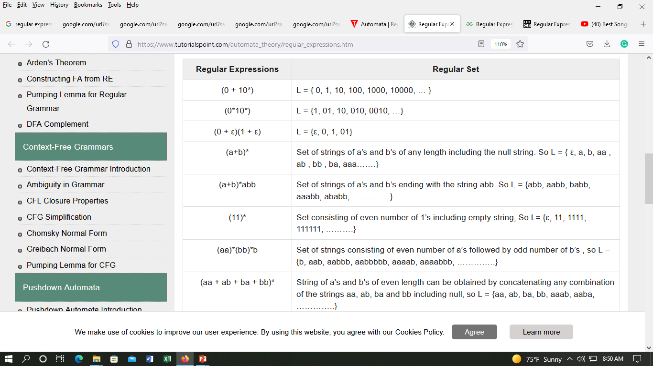
Regular Expression

Slide 9
Algorithm: Transform a Regular Expression into a Finite Automaton
Start by placing the regular expression on the edge between a start and final state:
Regular expression
Start
R
i
R + S
j
transforms to
i
S
j
i
RS
R
S
j
transforms to
i
j
R
i
R*
Λ
Λ
j
transforms to
i
j

Slide 10
Regular Expression

Slide 11
Algebraic properties of REs
r⏐s = s⏐r | ⏐ is commutative
r⏐(s⏐t) = (r⏐s)⏐t | ⏐ is associative
r (st) = (rs)t | concatenation is associative
r(s⏐t) = rs⏐rt (s⏐t)r = sr⏐tr | concatenation distributes over ⏐
εr = r rε = r | ε is the identity for concatenation
r * = (r⏐ε)* | ε is contained in *
r ** = r* | * is idempotent

Slide 12
Converting DFAs to REs
Combine serial links by concatenation
Combine parallel links by alternation
Remove self-loops by Kleene closure
Select a node (other than initial or final) for removal. Replace it with a set of equivalent links whose path expressions correspond to the in and out links
Repeat steps 1-4 until the graph consists of a single link between the entry and exit nodes.

Slide 13
Example
a
a
start
d
b
d
a
b
d
0
1
2
3
4
5
c
c
d
b
b
6
c
7
parallel edges become alternation
start
d
a|b|c
d
a
d
0
1
2
3
4
5
d
b
b|c
6
7

Slide 14
Example
start
d
a|b|c
d
a
d
0
1
2
3
4
5
d
b
b|c
6
7
serial edges become concatenation
start
d (a|b|c) d
a
d
0
3
4
5
b (b|c) d

Slide 15
Example
start
d (a|b|c) d
a
d
0
3
4
5
b (b|c) d
Find paths that can be “shortened”
start
d (a|b|c) d
a
d
0
3
4
5
b(b|c)da

Slide 16
Example
start
d (a|b|c) d
a
d
0
3
4
5
b(b|c)da
eliminate self-loops
start
d (a|b|c) d
a
(b(b|c)da)*d
0
3
4
5
serial edges become concatenation
start
d (a|b|c) d
a
(b(b|c)da)*d
0
5

Slide 17
Relationship among RE, NFA, DFA
The set of strings recognized by an NFA can be described by a Regular Expression.
The set of strings described by a Regular Expression can be recognized by an NFA.
The set of strings recognized by an DFA can be described by a Regular Expression.
The set of strings described by a Regular Expression can be recognized by an DFA.
DFAs, NFAs, and Regular Expressions all have the same “power”. They describe “Regular Sets” (“Regular Languages”)
The DFA may have a lot more states than the NFA.

Slide 18
Arden’s Theorem
Let P and Q be two regular expressions over alphabet Σ.
If P does not contain null string,
  Then R = Q + RP has a unique solution that is R = QP*

Slide 19
Proof
R = Q + RP….. ….. ….. (1)
  Put the value of R in the R.H.S.
R = Q + (Q + RP)P = Q + QP + RP²
  When we put the value of R again and again we get the following equation
R = Q + QP + QP² + QP³…..
R = Q(1 + P + P² + P³ + ……
R = Q(є + P + P² + P³ + ……
  The second part of the product on the L.H.S can be replaced with the kleen closure. So the equation becomes
R = QP*

Slide 20
Algebraic form
For getting the regular expression for the automata we first create equations of the given form for all the states
  q₁ = q₁w₁₁ + q₂w₂₁ + … + q_{n}w_{n1} + є (q₁ is the initial state)
  q₂ = q₁w₁₂ + q₂w₂₂ + … + q_{n}w_{n2}
  ……
  ……
  ……
  q_{n}= q₁w_{1n} + q₂w_{2n} + … + q_{n}
w_{ij} is the regular expression representing the set of labels of edges from q_{i} to q_{j}

Slide 21
Algebraic form
Then we solve these equations to get the equation for q_{i} in terms of w_{ij} and that expression is the required solution, where q_{i} is a final state.

Slide 22
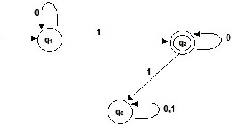
Example
Find the regular expression

Slide 23
Example
Now let us form the equation
q₁ = q₁0 + є
q₂ = q₁1 + q₂0
q₃ = q₂1 + q₃0 + q₃1
Solving the equations
q₁ = є0* (using Arden’s theorem; here Q = є , P = 0, R = q₁)
q₁ = 0*
q₂ = 0*1 + q₂0
q₂ = 0*1(0)* (here Q = 0*1, P = 0, R = q₂)
Hence, 0*10* is the regular expression for the above deterministic finite automaton.

Slide 24
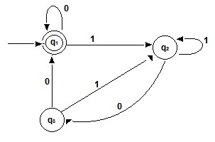
Example
Find the regular expression

Slide 25
Example
R = Q + RP
R = QP*
Now let us form the equation
  q₁ = q₁0 + q₃0 + є
  q₂ = q₁1 + q₂1 + q₃1
  q₃ = q₂0
Solving the equations
  q₂ = q₁1 + q₂1 + (q₂0)1 (Replace q₃ = q₂0)
  q₂ = q₁1 + q₂(1 + 01)
  (using Arden’s theorem; here Q = q₁1 , P = (1 + 01), R = q₂)
  q₂ = q₁1 (1 + 01)*

Slide 26
Example
R = Q + RP
R = QP*
Now let us form the equation
  q₁ = q₁0 + q₃0 + є
  q₂ = q₁1 + q₂1 + q₃1
  q₃ = q₂0
q₂ = q₁1 (1 + 01)*
Now solve for q₁
  q₁ = q₁0 + q₃0 + є (Replace q3)
  q₁ = q₁0 + q₂00 + є (Replace q₂ )
  q₁ = q₁0 + q₁1(1 + 01*)00 + є
  q₁ = q₁(0 + 1(1 + 01)*00) + є
  q₁ = є (0 + 1(1 + 01)*00)*
  q₁=(0 + 1(1 + 01)*00)*
Hence, the regular expression is (0 + 1(1 + 01)*00)*

Slide 27
Equivalence Of Two Finite Automata
Let M and M' be two finite automata over Σ.
Construct a comparison table consisting of n + 1 columns. where n is the number of input symbols.
  First column consists of pairs of vertices of the form (q, q')
  where q ∈ M and q‘∈ M'.
  Progress with the input symbol and write their entries.

Slide 28

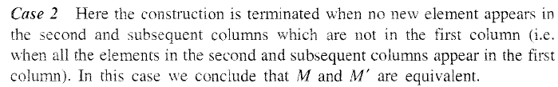
Equivalence Of Two Finite Automata

Slide 29
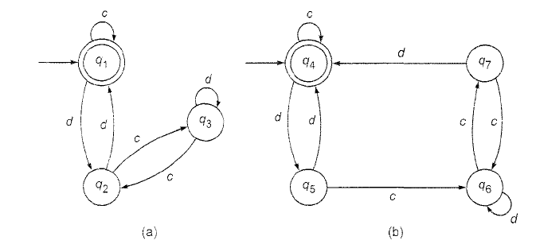
Example

Slide 30
Example
(q,q’) | (q_{c},q’_{c}) | (q_{d},q’_{d})
q₁, q₄ | q₁, q₄ | q₂, q₅

Slide 31
Example
(q,q’) | (q_{c},q’_{c}) | (q_{d},q’_{d})
q₁, q₄ | q₁, q₄ | q₂, q₅
q₂, q₅ | q₃, q₆ | q₁, q₄

Slide 32
Example
(q,q’) | (q_{c},q’_{c}) | (q_{d},q’_{d})
q₁, q₄ | q₁, q₄ | q₂, q₅
q₂, q₅ | q₃, q₆ | q₁, q₄
q₃, q₆ | q₂, q₇ | q₃, q₆

Slide 33
Example
(q,q’) | (q_{c},q’_{c}) | (q_{d},q’_{d})
q₁, q₄ | q₁, q₄ | q₂, q₅
q₂, q₅ | q₃, q₆ | q₁, q₄
q₃, q₆ | q₂, q₇ | q₃, q₆
q₂, q₇ | q₃, q₆ | q₁, q₄
Since every pair in first column shows same
characteristics M and M’ are equivalent

Slide 34
END

